Slide 1
COMMUNICATIONS SOCIETY
Ing. Carlos Andrés Lozano Garzón
Membership Development Coordinator
ComSoc LA
calozanog@comsoc.org

Slide 2

ComSoc Services
Meetings & Conferences
Online Services
Recognition & Awards
Technical Activities
Education, Tutorials & Certification
Chapter Support & DLTs
Publications & Digital Library

Slide 3
IEEE e-Membership for Developing Nations
Electronic membership option (no print) with reduced dues to members who live in developing nations
New and renewing higher grade members, not students
Latin America dues $54; half price after 1 March: $27
Qualifying countries include almost all countries in Latin America – Argentina, Brazil, Chile, Ecuador, El Salvador, Guatemala, Honduras, Mexico, Nicaragua, Panama, Uruguay, others
More info --www.ieee.org/membership_services/membership/join/emember.html

Slide 4
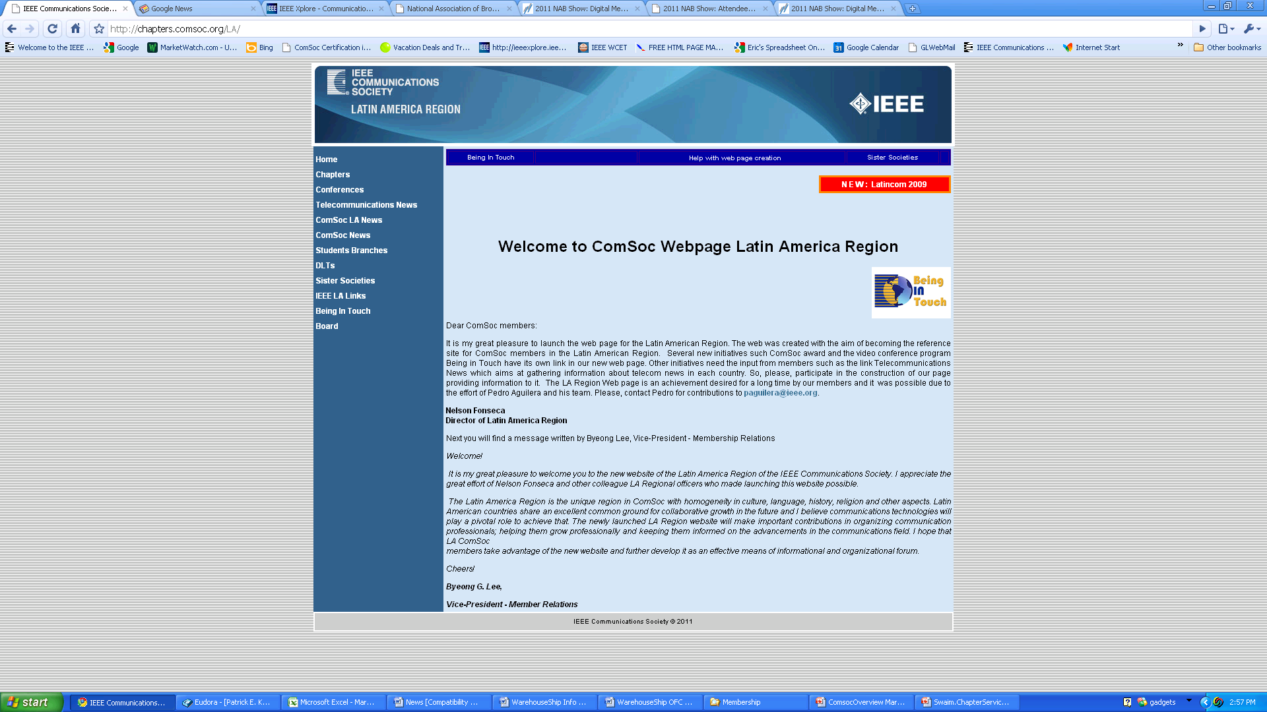
ComSoc Chapter Services
Distinguished Lecturers Tours
DLs online
Region Websites

Slide 5
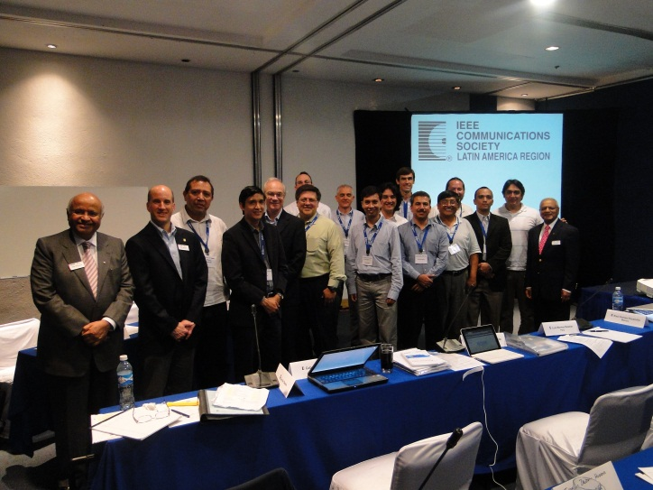
RCCC 2011
Jorge Calvo - Costa Rica
Gabriel Astudillo – Ecuador
Luis Monte Bazalar – Peru
Raul Gomez Escamilla – Mexico
Rodrigo Garcia -Guadalajara
Pedro Aguilera - Chile
Jorge Hedderwick – Argentina
Thomas Hobbins – Uruguay
Carlos Velasquez – Colombia
Ignacio Z. Huerta – Puebla
Armando Rivera - Guatemala
César Vargas Rosales – Monterrey
RCCC 2011

Slide 6
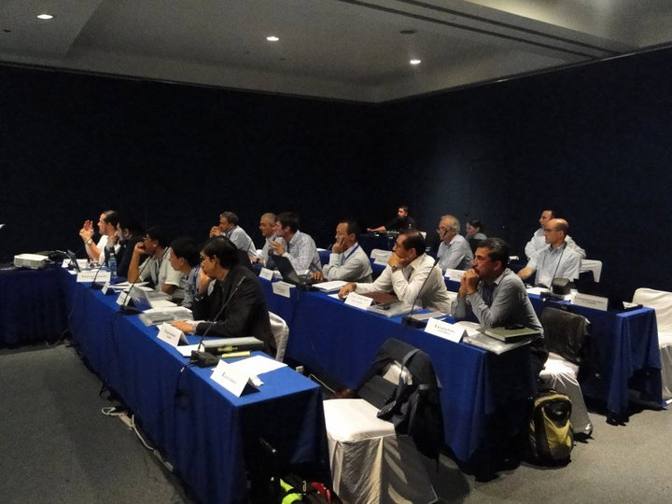
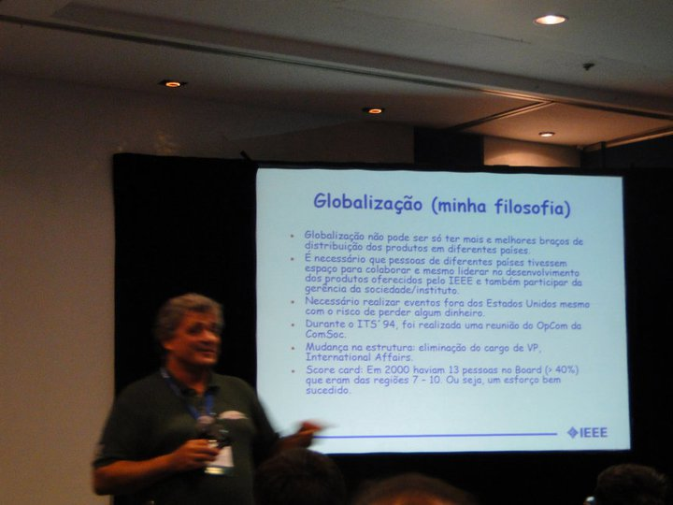
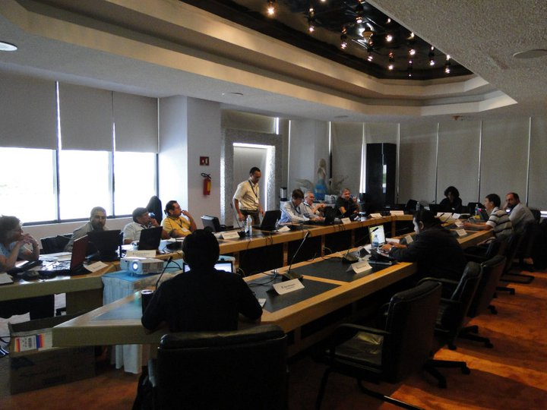
RCCC 2011

Slide 7
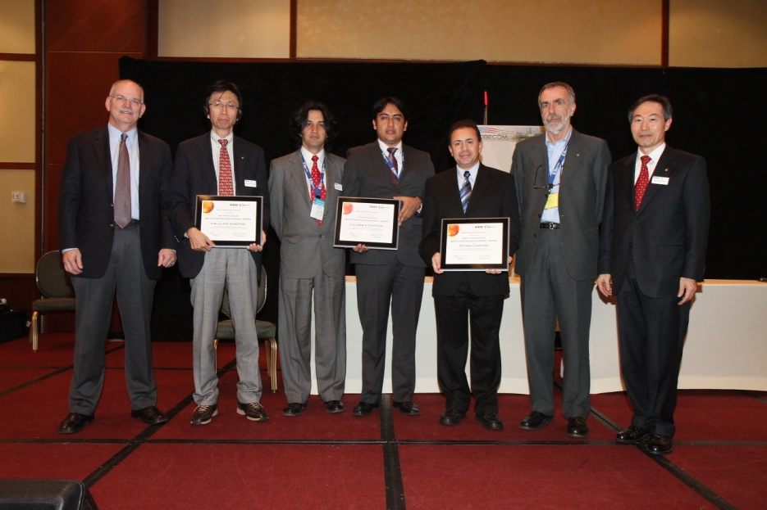



ComSoc Chapter Services
Membership Development Support Grant
Chapter Achievement Awards
Chapter of the Year
Forums, Blogs, Social Media…
Student Travel Grants

Slide 8
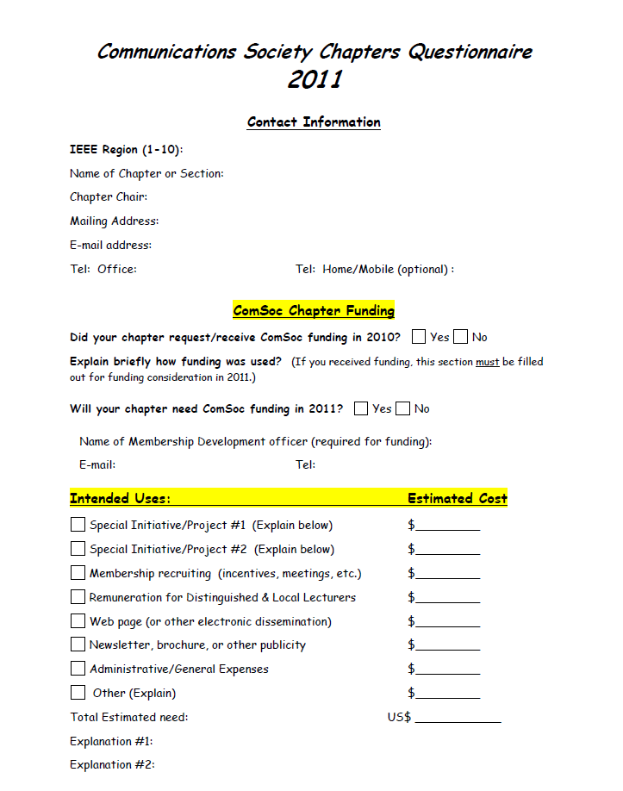

ComSoc Chapter Services
Chapter Questionnaire & Financial Aid

Slide 9

Distinguished Lecturers/Speakers Program
Provided as a service to our local chapters, Distinguished Lecture Tours and individual Distinguished Speakers can be arranged in response to a request from one or more Chapter Chairs. They may also be initiated by Regional Directors, the Director – Membership Programs Development, or the Vice President – Member Relations. Although tours and individual lectures are organized to benefit existing members and Chapters, they can also be effective in generating membership and encouraging new chapter formation.
Lecture tours will be supported as the budget allows in each of our four Regions: Asia/Pacific, Europe-Africa-Middle-East, Latin America, and North America. The Director in each region plays a key role as facilitator.
For more information go to www.comsoc.org and “About ComSoc;” scroll to Member Programs; then Distinguished Lecturers.

Slide 10

WCET Certification
For practicing wireless engineers in early stages of career; recommend degree & 3 years experience
Sophisticated 150 question exam; 2 exam windows annually; over 100 volunteers involved
Multiple seat discounts available; Cincinnati Bell; Savannah River Labs; US Cellular
Industry Advisory Board; Corporate support; MCPC franchise in Japan
Training and Tutorials
The WEBOK!!! 2009 edition.
Industry events best for promotion
www.ieee-wcet.org
2011 Fall exam window: 2 October – 29 October
Application period open until 16 September

Slide 11








ComSoc Chapter Services

Slide 12
Desarrollo de Membresía Latino América

Slide 13
Membresía por países de
Latino América 2009 - 2010

Slide 14
CONSEJO CAPANA

Slide 15
CARIBE

Slide 16
CONSEJO MEXICO

Slide 17
CONSEJO ANDINO

Slide 18
CONSEJO BRAZIL

Slide 19
CONO SUR

Slide 20
Membresía General de la Región a Febrero de 2010 - 2011
Totales
2010 – 1091
2011 - 1295

Slide 21
DLT AND DSP PROGRAM

Slide 22
LA DLT 2008
 | ARGENTINA | BAHIA | BOLIVIA | BRASILIA | CHILE | CENTRO OCCIDENTE | COLOMBIA | COSTA RICA | ECUADOR | EL SALVADOR | GUADALAJARA | GUATEMALA | MEXICO | MONTERREY | MORELOS | PANAMA | PERU | PUEBLA | PUERTO RICO & CARIBBEAN | RIO DE JANEIRO | SOUTH BRAZIL | TRINIDAD & TOBAGO | URUGUAY | VENEZUELA
Ulema Mehmet |  |  |  |  |  |  | ●
Stefano Bregni |  |  | ● |  |  |  | ● |  |  |  |  |  |  |  |  |  | ●
Ian Akyildiz |  |  |  |  |  |  |  |  | ● |  |  |  |  |  |  |  | ●
Mike Devetskiotis | ● |  |  |  | ● |  |  |  |  |  |  |  |  |  |  |  |  |  |  |  |  |  | ●
Participación: 7 Capítulos

Slide 23
LA DLT 2009
 | ARGENTINA | BAHIA | BOLIVIA | BRASILIA | CHILE | CENTRO OCCIDENTE | COLOMBIA | COSTA RICA | ECUADOR | EL SALVADOR | GUADALAJARA | GUATEMALA | MEXICO | MONTERREY | MORELOS | PANAMA | PERU | PUEBLA | PUERTO RICO & CARIBBEAN | RIO DE JANEIRO | SOUTH BRAZIL | TRINIDAD & TOBAGO | URUGUAY | VENEZUELA
Roch Glitho | ● |  |  |  |  |  |  |  |  |  |  |  |  |  |  |  |  |  |  | ● |  |  | ●
Andrea Goldsmith |  |  |  |  |  |  | ● |  |  |  | ● |  |  | ●
Henning Schulzrinne |  |  | ● |  |  |  |  |  | ● |  |  |  |  |  |  |  | ●
Abbas Jamalipour | ● |  |  |  | ● |  | ●
Javan Erfanian |  |  | ● |  |  |  |  |  |  |  |  | ● |  |  |  | ● | ●
Participación: 12 Capítulos

Slide 24
DLT LA 2010
 | ARGENTINA | BAHIA | BOLIVIA | BRASILIA | CHILE | CENTRO OCCIDENTE | COLOMBIA | COSTA RICA | ECUADOR | EL SALVADOR | GUADALAJARA | GUATEMALA | MEXICO | MONTERREY | MORELOS | PANAMA | PERU | PUEBLA | PUERTO RICO & CARIBBEAN | RIO DE JANEIRO | SOUTH BRAZIL | TRINIDAD & TOBAGO | URUGUAY | VENEZUELA
Arun Somani |  |  |  |  |  |  | ●
Stamatios Kartalopoulos |  |  |  |  |  | ● |  |  |  |  | ●
Stamatios Kartalopoulos
  Guanajuato
Participación: 3 Capítulos
1 Sección

Slide 25
DLT LA 2011 ?
 | ARGENTINA | CHILE | URUGUAY | BOLIVIA | COLOMBIA | ECUADOR | PERU | VENEZUELA | COSTA RICA | EL SALVADOR | GUATEMALA | PUERTO RICO & CARIBBEAN | PANAMA | TRINIDAD & TOBAGO | CENTRO OCCIDENTE | GUADALAJARA | MEXICO | MONTERREY | MORELOS | PUEBLA | BAHIA | RIO DE JANEIRO | SOUTH BRAZIL | BRASILIA
DL #1
DL #2
DL #3
DL #4
DL #5

Slide 26
IEEE LATINCOM 2011
Belém - Pará, Brazil
Octubre de 2011
SUSTAINABLE COMMUNICATIONS FOR A GREEN WORLD
www.ieee-latincom.org

Slide 27
Contactos
José David Cely Callejas
Regional Director
ComSoc LA j.d.cely@ieee.org
Ing. Carlos Andrés Lozano Garzón
Membership Development Coordinator
ComSoc LA calozanog@comsoc.org

